Slide 1
Strategy design pattern

Slide 2
Strategy Design Pattern
Pattern Name
Strategy Design Pattern
a plan of action designed to achieve a goal
Intent
Define a family of algorithms, encapsulate each one, and make them interchangeable. Strategy lets the algorithm vary independently from the clients that use it.

Slide 3
Strategy Design Pattern
Algorithm A
Problem
Run-time
Decision
Algorithm B
Algorithm C

Slide 4
E.g.-Strategy Design Pattern
Linear
Search
Binary
Search
Searching

Slide 5
Problem
Allows you change the family of algorithms, encapsulate each one, and make them interchangeable

Slide 6
Applicability
Mostly used when we are not sure which algorithm is best for the particular problem at compile time.

Slide 7
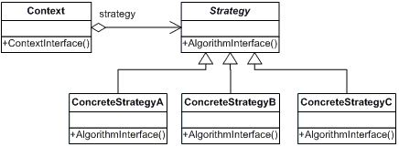
Structure

Slide 8
Benefits
Families of related algorithms. Hierarchies of Strategy classes define a family of algorithms or behaviours for contexts to reuse. Inheritance can help factor out common functionality of the algorithms.
Strategies eliminate conditional statements. The Strategy pattern offers an alternative to conditional statements for selecting desired behaviour.
A choice of implementations. Strategies can provide different implementations of the same behaviour. The client can choose among strategies with different time and space trade-offs.

Slide 9
Drawbacks
Clients must be aware of different Strategies. The pattern has a potential drawback in that a client must understand how Strategies differ before it can select the appropriate one.
Increased number of objects. Strategies increase the number of objects in an application.

